Slide 1
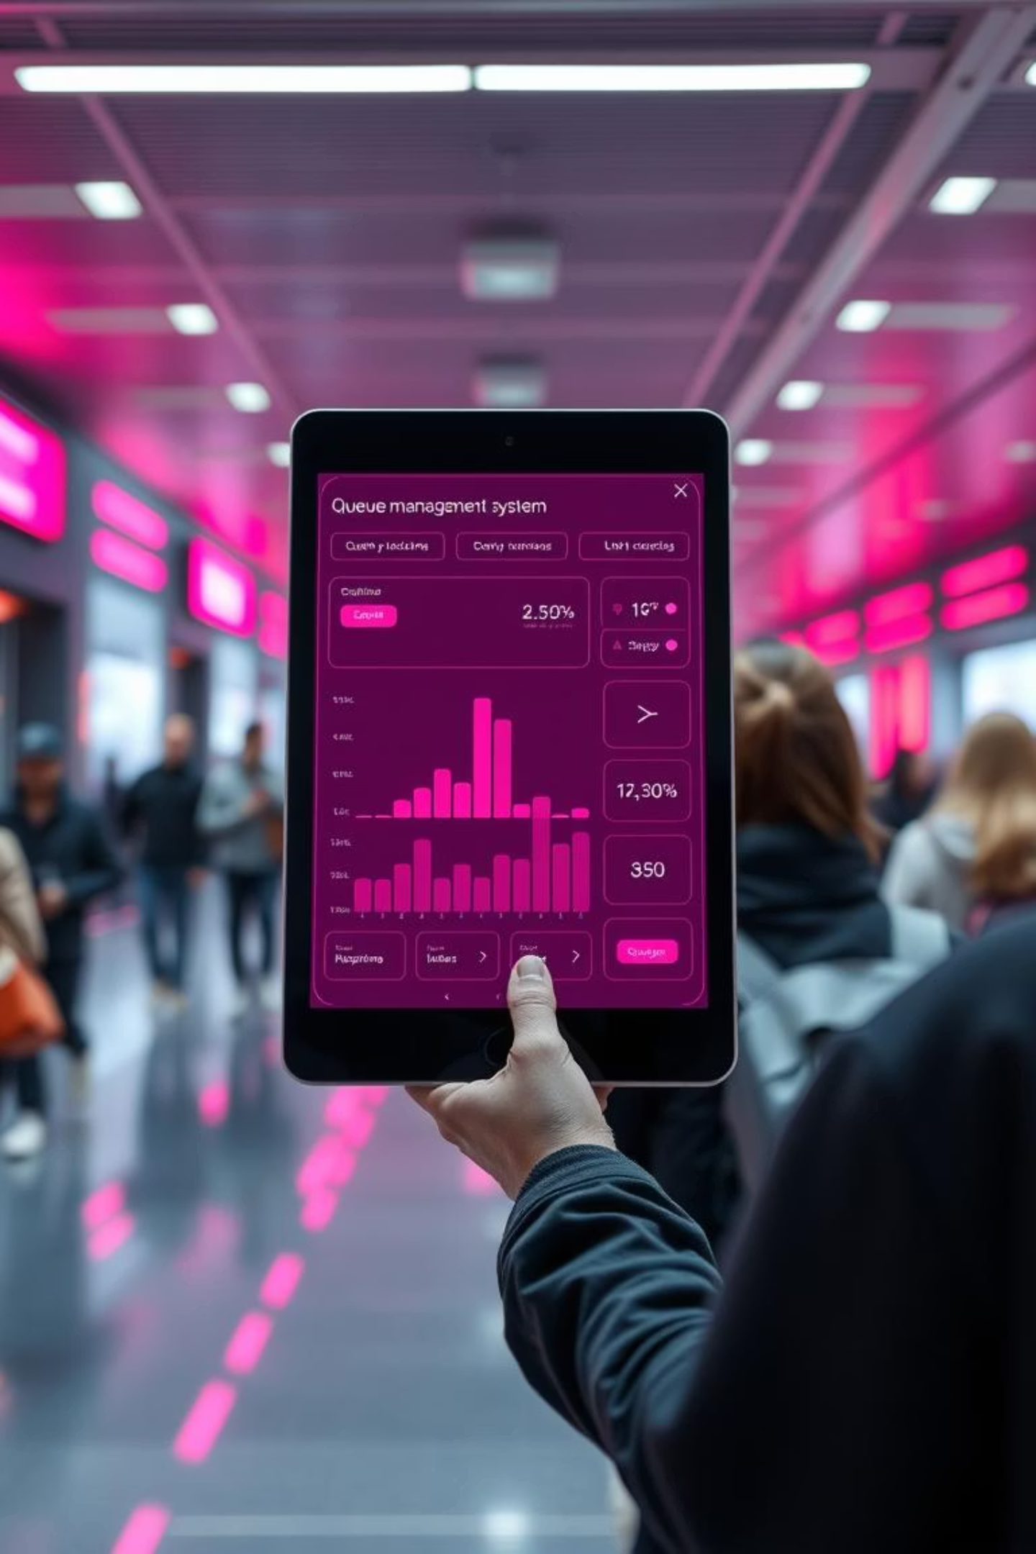
QueueAway™
AI-Powered • IoT-Enabled • Blockchain-Secured Smart Queue Management
Presented by Team 1023

Slide 2
The Problem: Waiting is Wasted Time
Physical queues are a pervasive source of frustration, inefficiency, and even health risks in our daily lives. From doctor's offices to government agencies, people collectively lose countless hours standing in line, often in chaotic and unfair environments.
Lost Hours
Lack of Management
Individuals spend an average of 3-5 hours weekly in physical queues, leading to significant productivity loss.
Small clinics, school offices, and local drives often lack any form of digital queue management, relying on outdated systems.
Chaos & Health Risks
High Entry Barrier
Unmanaged queues foster disorder, perceived unfairness, overcrowding, and increased exposure to health risks.
Existing solutions are expensive, complex, and require specialized hardware, making them inaccessible for small businesses.

Slide 3





Our Solution: QueueAway™
QueueAway™ is a revolutionary, browser-based smart queue management system designed to eliminate the inefficiencies of physical waiting lines. Leveraging cutting-edge AI, IoT, and blockchain technologies, it provides a seamless, fair, and transparent queuing experience for everyone.
Browser-Based
AI-Powered
IoT-Ready
Access from any device with an internet connection—no downloads required.
Accurate wait time predictions save users valuable hours every week.
Future-proof integration for automated check-ins and seamless queue tracking.
Blockchain-Secured
Zero-Hardware
Ensures queue integrity and prevents any manipulation of the order.
Works on any existing device, eliminating the need for expensive additional equipment.

Slide 4
How It Works: Simple Steps to Smarter Queues
QueueAway™ streamlines the queuing process into four intuitive steps, making it easy for both organizers and users to adopt.
01
02
Create a Smart Queue
Join Queue
Organizers set up a new digital queue in seconds via a simple browser interface, customizing service types and capacity.
Users enter their details or conveniently scan a QR code at the physical location to get their virtual spot in line.
03
04
Real-time Updates
Smart Notifications
Users receive instant, live updates on their position in the queue and estimated wait times, reducing anxiety and uncertainty.
Automated alerts notify users when their turn is approaching, allowing them to optimize their waiting time and arrive precisely when ready.

Slide 5

Under the Hood: Tech Stack & Innovation
QueueAway™ is built on a robust, scalable, and secure technical foundation, integrating modern web technologies with advanced algorithms and distributed ledger capabilities.
HTML, CSS, JavaScript: Ensures a lightweight, fast, and universally accessible web application.
AI-Inspired Wait Time Prediction: Our proprietary algorithm analyzes real-time data to provide highly accurate wait time estimates, adapting to dynamic queue conditions.
IoT-Ready Integration: Designed for seamless compatibility with future hardware like sensors for automated check-ins, capacity monitoring, and enhanced queue flow.
Blockchain-Ready Backend: Future-proofed with the capability to integrate blockchain technology for immutable queue records, ensuring unparalleled transparency and preventing any unauthorized order manipulation.

Slide 6





Impact: Business Value & Societal Benefits
QueueAway™ offers significant advantages for both service providers and end-users, while also contributing positively to community well-being.
Time Savings
Reduced Overcrowding
Enhanced Fairness
Drastically reduces wait times for customers and optimizes staff allocation for businesses.
Minimizes physical gathering in waiting areas, improving comfort and public health safety.
Transparent queue order prevents line-cutting and ensures equitable service for all.
Cost-Effective Adoption
Monetization Potential
Zero hardware requirement makes it accessible for small businesses and organizations.
Future revenue streams include premium analytics, API access, and advanced enterprise features.

Slide 7

Future Vision: Our Roadmap to Success
We have a clear, phased approach to develop QueueAway™ from an MVP into a fully integrated, market-leading solution.
MVP Launch
Feature Expansion
Scalability & Security
Blockchain Integration
Each phase builds upon the last, ensuring a robust and well-validated product as we scale.

Slide 8

Meet Team 1023
We are a dedicated team passionate about solving real-world problems through innovative technology.
Raunak Taneja
Daiwik Puri
Aansh Goel
(1023C)
(1023A)
(1023B)
"Committed to revolutionizing queue management for a more efficient and equitable world."

